Slide 1

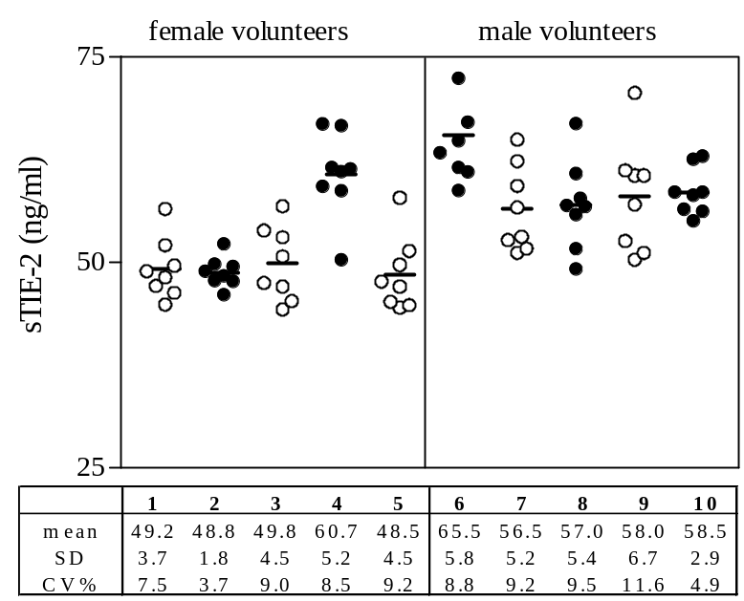
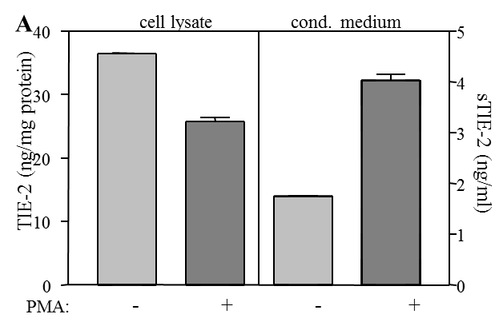
ReliaTech GmbH
Monoclonal antibodies for human TIE-2/tek
Fig. 1: sTIE-2 levels in human serum. Sera from 10 healthy volunteers were analysed by ELISA. For each individual, 8 samples were collected within one week. From these 8 samples, the mean and the standard deviation (SD) were calculated. The coefficient of variation is (CV) defined by SD/mean, expressed in %.
Fig. 2: Quantification of soluble and cellular TIE-2 by sandwich ELISA. A. CM and cell lysates from HUVECs treated with PMA (25ng/ml) or left untreated were analysed by Sandwich ELISA for the concentrations of sTIE-2 or TIE-2. For capturing anti-human TIE-2 Cl.16 [#101-M54] was used, for the detection a mixture of biotinylated anti-human TIE-2 Cl. 2 [#101-M50] and Cl.9 [#101-M52].
http://www.reliatech.de / orders@reliatech.de

Slide 2
60
A
B
40
sTIE-2 (ng/ml)
20
0
1
2
3
4
5
6
7
8
1
2
3
4
5
6
7
8
60
C
D
40
sTIE-2 (ng/ml)
20
0
1
2
3
4
5
6
7
8
1
2
3
4
5
6
7
8
Fig. 3: Specificity of ELISA measurements and sTIE-2 levels in human serum. Sera from four healthy volunteers (A-D) were depleted by immunoprecipitation using anti-mouse IgG agarose together with several TIE-2 specific and non-specific monoclonal antibodies prior to ELISA. (1) serum sample; (2) anti-mouse IgG agarose alone; (3) aTEK2 [#101-M50]; (4) aTEK9 [#101-M52] ; (5) aTEK16 [#101-M54]; (6) sTIE-1-specific mab 7E3; (7) VEGFR-1-specific mab [#101-M28]; (8) VEGFR-2 specific mab [#101-M32].
Literatur: Reusch et al., Identification of a soluble form of the angiopoietin receptor TIE-2 released from endothelial cells and present in human blood. Angiogenesis. 2001;4(2):123-31.
http://www.reliatech.de / orders@reliatech.de

